Slide 1

ahmedfmohamed1234567@gmail.com
Sales Data Warehouse Project
Growth Division

Slide 2

Requirements Analysis
Design Data Architecture
Project Initialization
Build Bronze Layer
Table of
Content
Build Silver Layer
Build Gold Layer
Analytics & Reporting

Slide 3

Requirements Analysis
Specifications
Data Warehouse Development (Data Engineering)
Data Sources: Load data from two separate systems (ERP and CRM), provided in CSV format.
Data Quality: Perform data cleansing and address any quality issues before analysis.
Integration: Merge the datasets into a unified, easy-to-navigate data model optimized for analytics.
Build a modern data warehouse using SQL Server to centralize sales data, supporting analytical reporting and data-driven decision-making.
Scope: Limit the project to the most recent data; historical data tracking is not needed.
Documentation: Deliver comprehensive documentation of the data model to assist both business users and analytics teams. --

Slide 4

Requirements Analysis
Objectives
BI: Analytics & Reporting (Data Analysis)
Customer Behavior
Product Performance
Create SQL-driven analytics to uncover valuable insights into:
Sales Trends

Slide 5
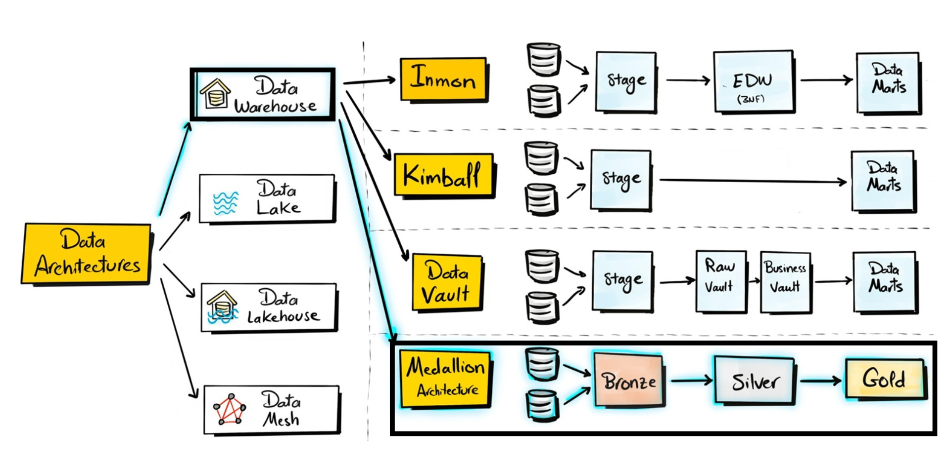
Design Data Architecture
Choose Data Management Approach

Slide 6
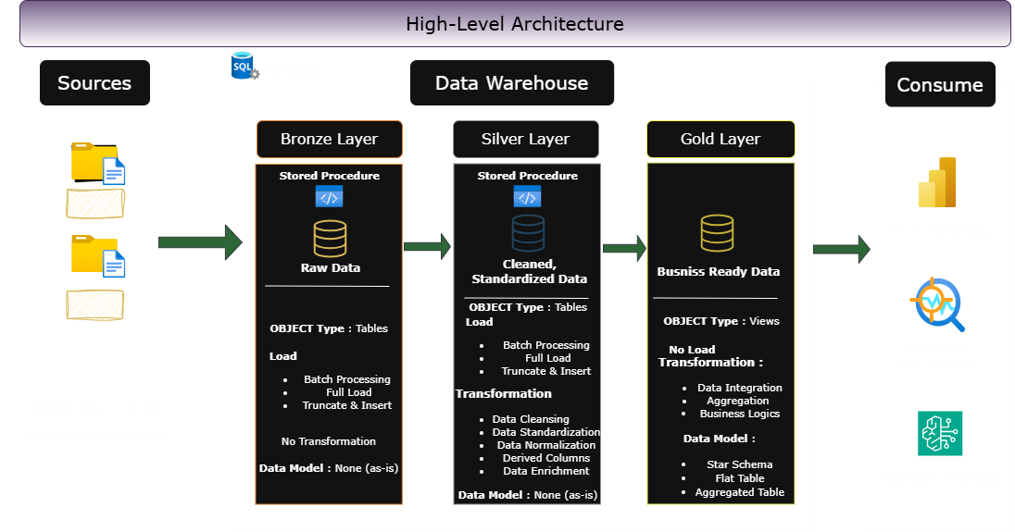
Design Data Architecture
Design the Layers

Slide 7
Project Initialization
Define Project Naming Conventions
General Rules
Use snake_case.
All names in English.
Avoid SQL reserved words.
Bronze & Silver Layer
Format: <source>_<entity>
Keep source table names unchanged.
Example: crm_customer_info
Gold Layer
Format: <category>_<entity>
Use business-aligned names.
Examples:
dim_customers-Dimension table
fact_sales-Fact table
Column Naming
Surrogate Keys: <table>_key e.g., customer_key
Technical Columns: dwh_<column> → e.g dwh_load_date
Stored Procedures
Format: load_<layer>
Examples: load_bronze, load_gold

Slide 8
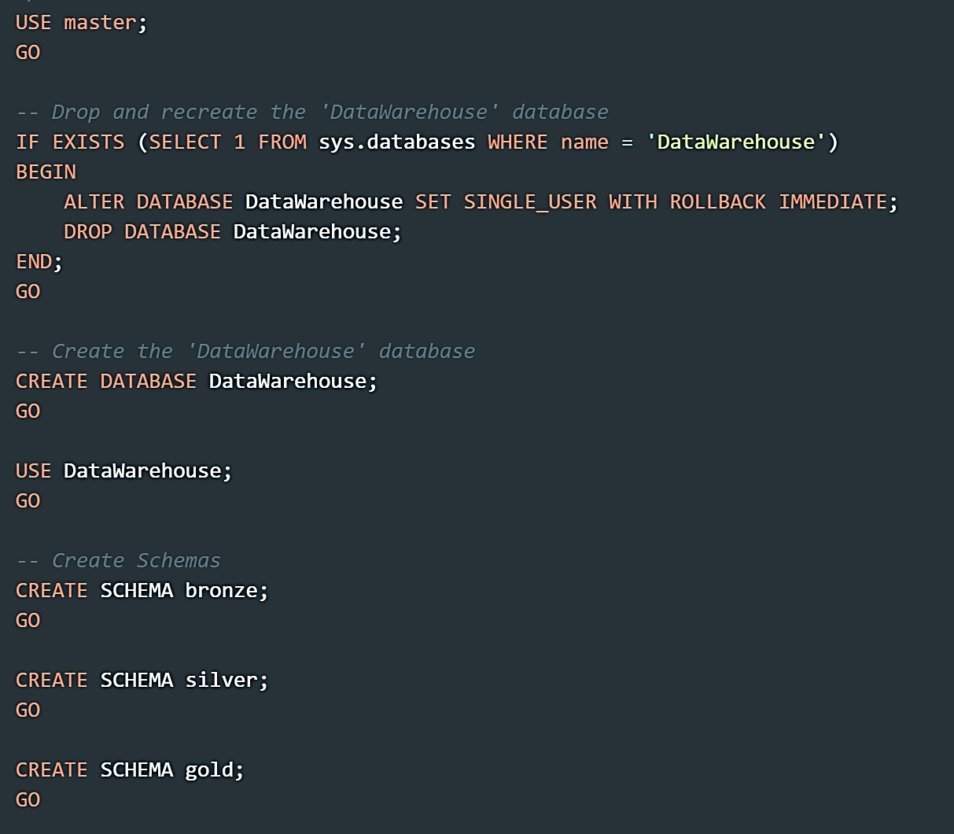
Project Initialization
Create Database and Schemas
Script Purpose:
This script creates a new database named 'Sales_Data_Warehouse' after checking if it already exists.
If the database exists, it is dropped and recreated. Additionally, the script sets up three schemas
within the database: 'bronze', 'silver', and 'gold'.
WARNING:
Running this script will drop the entire 'Sales_Data_Warehouse' database if it exists.
All data in the database will be permanently deleted. Proceed with caution
and ensure you have proper backups before running this script.

Slide 9
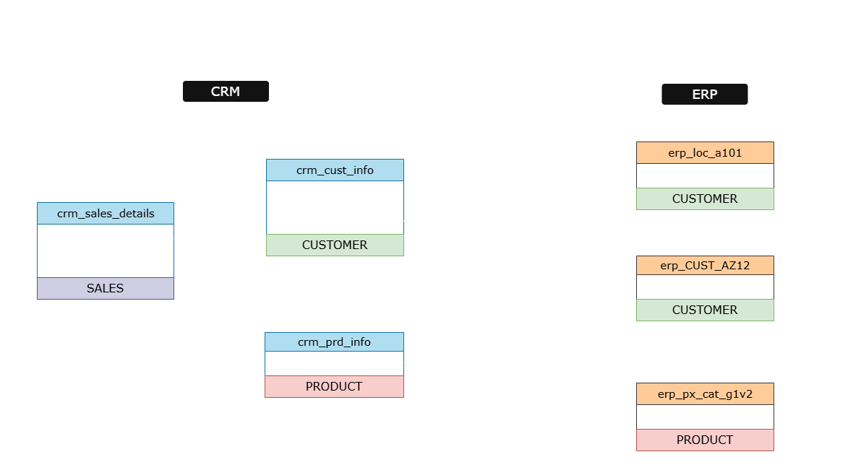
Build Bronze Layer
Analyzing: Source Systems

Slide 10
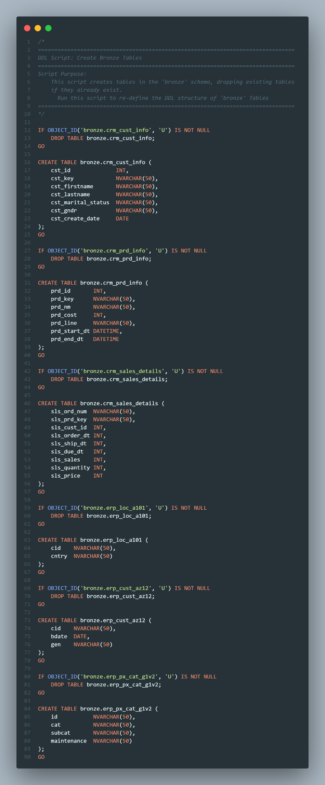
Build Bronze Layer
Coding: Data Ingestion
DDL Script: Create Bronze Tables
Script Purpose:
This script creates tables in the 'bronze' schema, dropping existing tables
if they already exist.
Run this script to re-define the DDL structure of 'bronze' Tables
crm_cust_info Table
crm_prd_info Table
crm_sales_details Table

Slide 11
Build Bronze Layer
Coding: Data Ingestion
erp_loc_a101 Table
erp_CUST_AZ12 Table
erp_px_cat_g1v2 Table

Slide 12
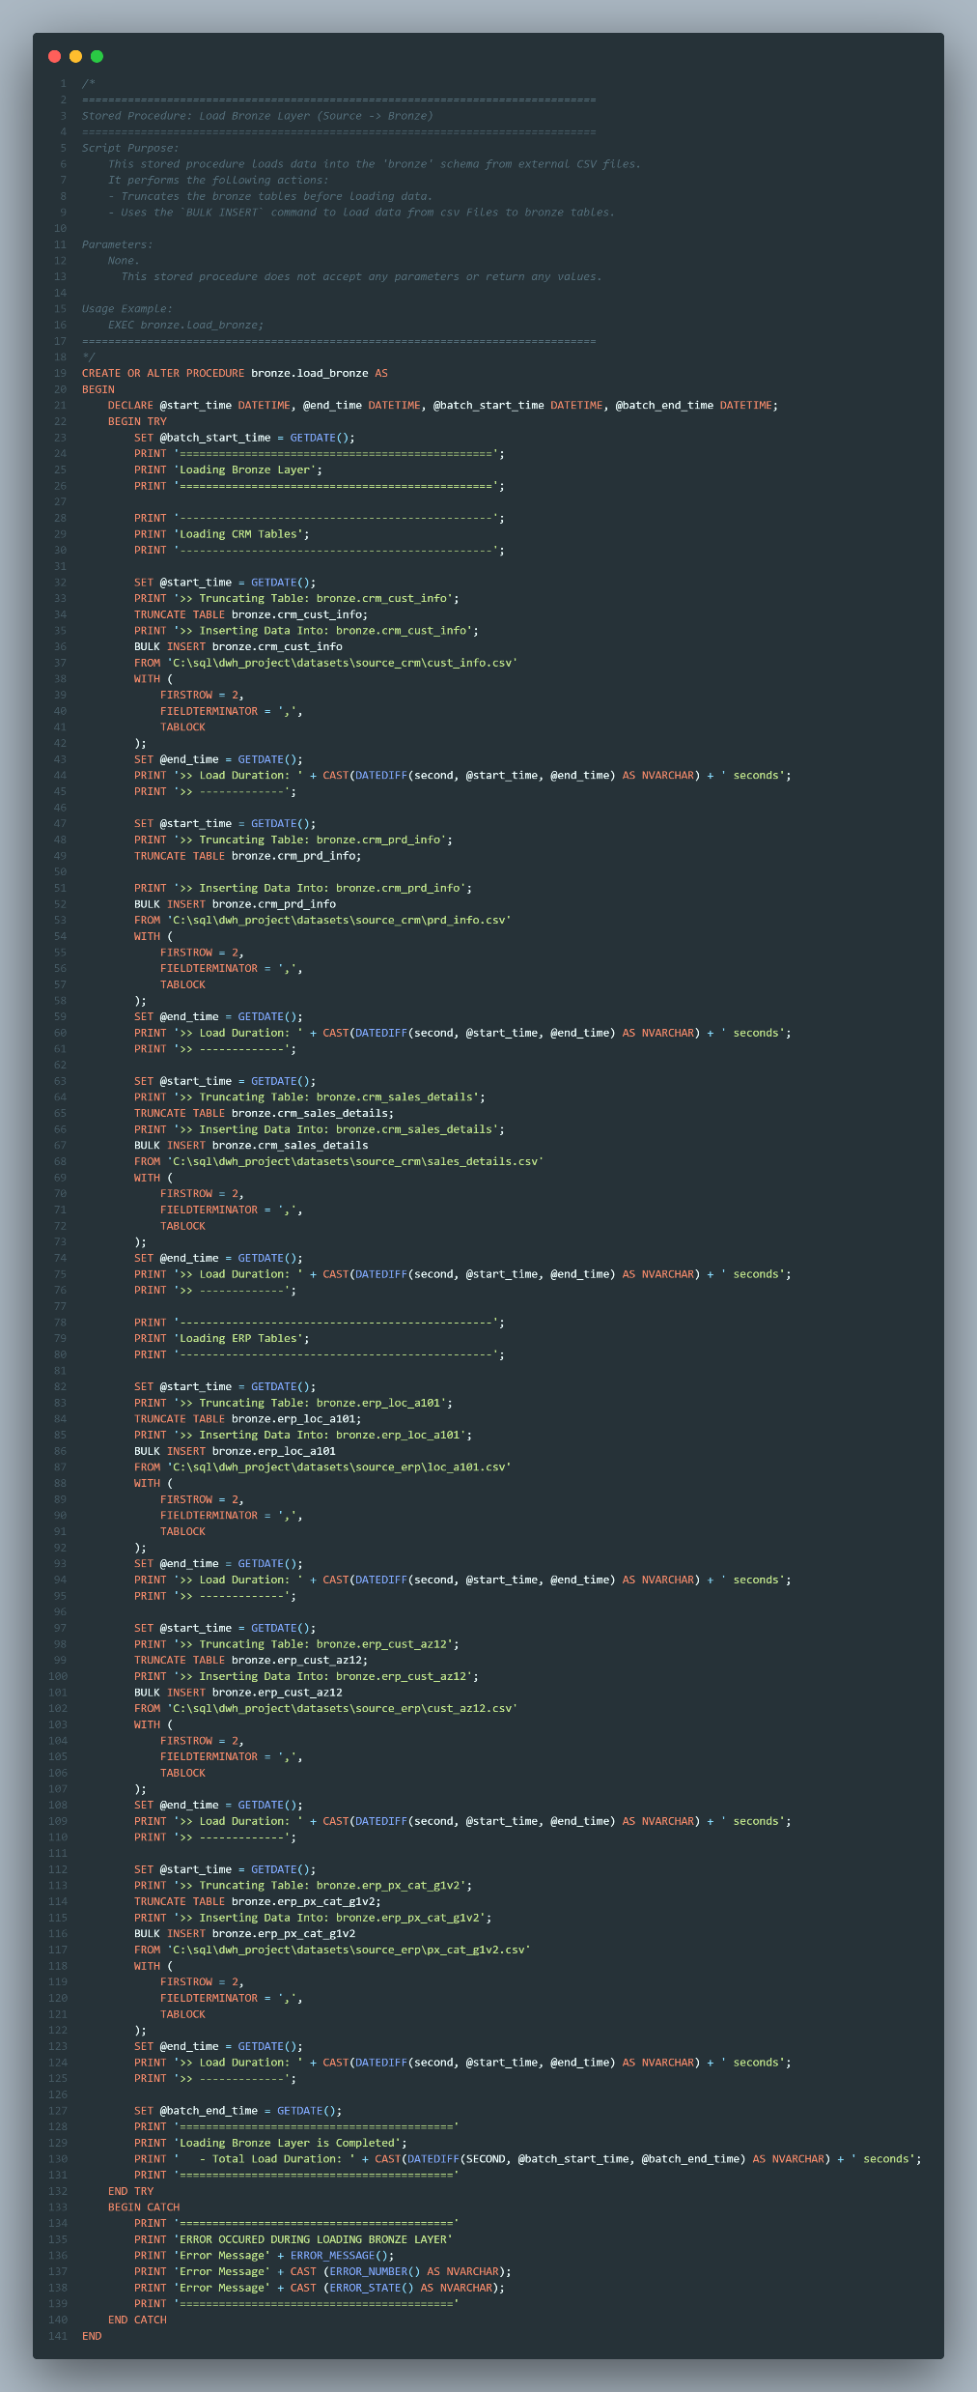
Build Bronze Layer
Validating: Data Completeness
Processing Load Bronze Script: Loads data into the 'bronze' schema from external CSV files.
Script Purpose:
It performs the following actions:
- Truncates the bronze tables before loading data.
- Uses the `BULK INSERT` command to load data from csv Files to bronze tables.
crm_cust_info Table
crm_prd_info Table
crm_sales_details Table

Slide 13
Build Bronze Layer
Coding: Data Ingestion
erp_loc_a101 Table
erp_CUST_AZ12 Table
erp_px_cat_g1v2 Table

Slide 14
Build Silver Layer
Analyzing: Source Systems

Slide 15
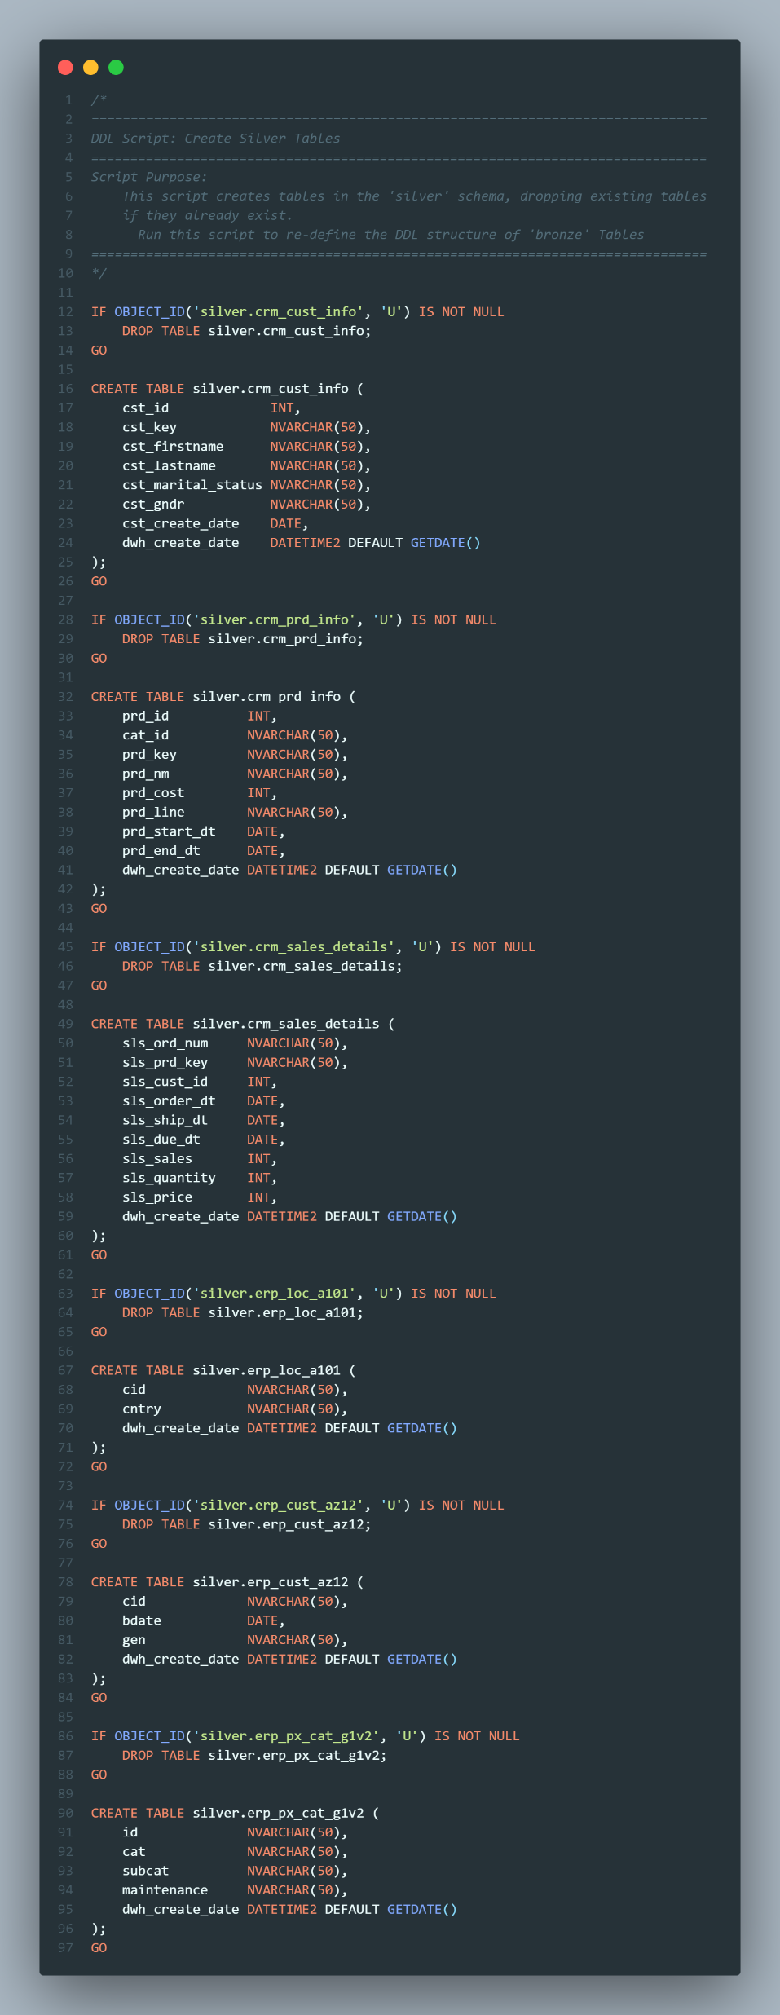
Build Silver Layer
Coding: Data Cleansing
Script Purpose:
This script creates tables in the 'silver' schema, dropping existing tables
if they already exist.
Run this script to re-define the DDL structure of 'bronze' Tables
crm_cust_info Table
crm_prd_info Table
crm_sales_details Table

Slide 16
Build Silver Layer
Coding: Data Cleansing
erp_loc_a101 Table
erp_CUST_AZ12 Table
erp_px_cat_g1v2 Table

Slide 17
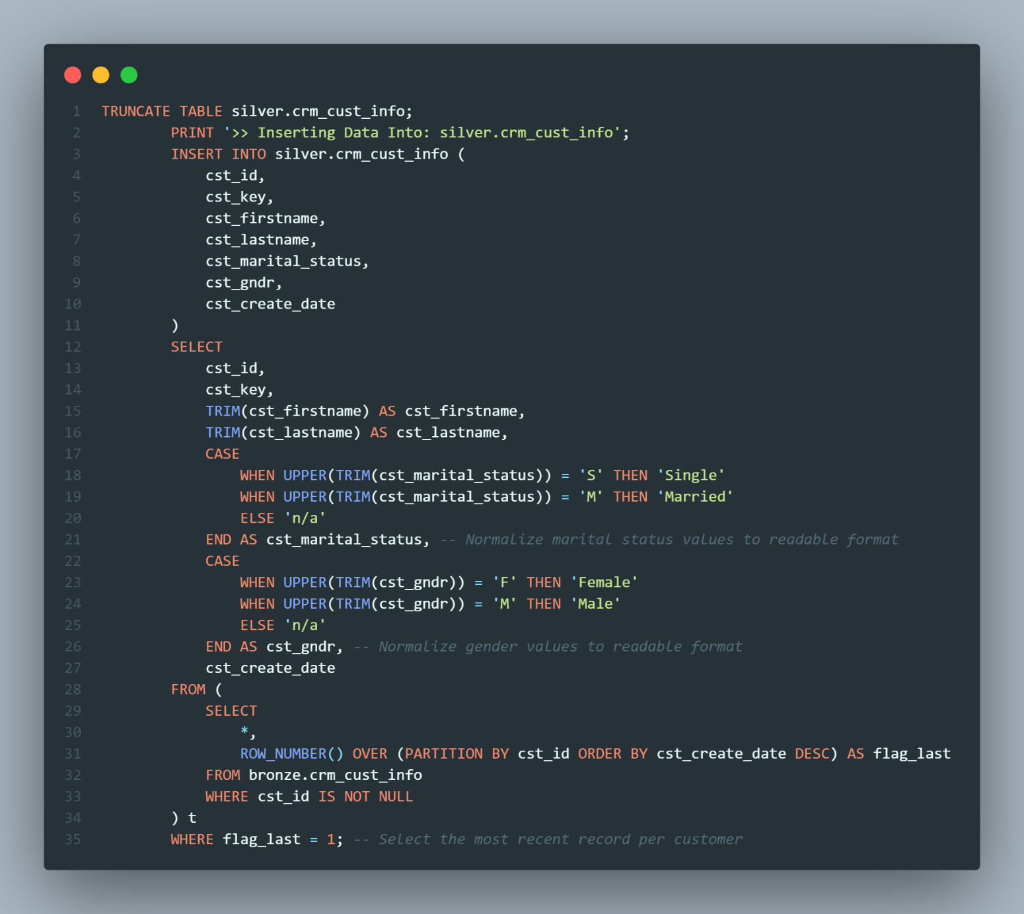
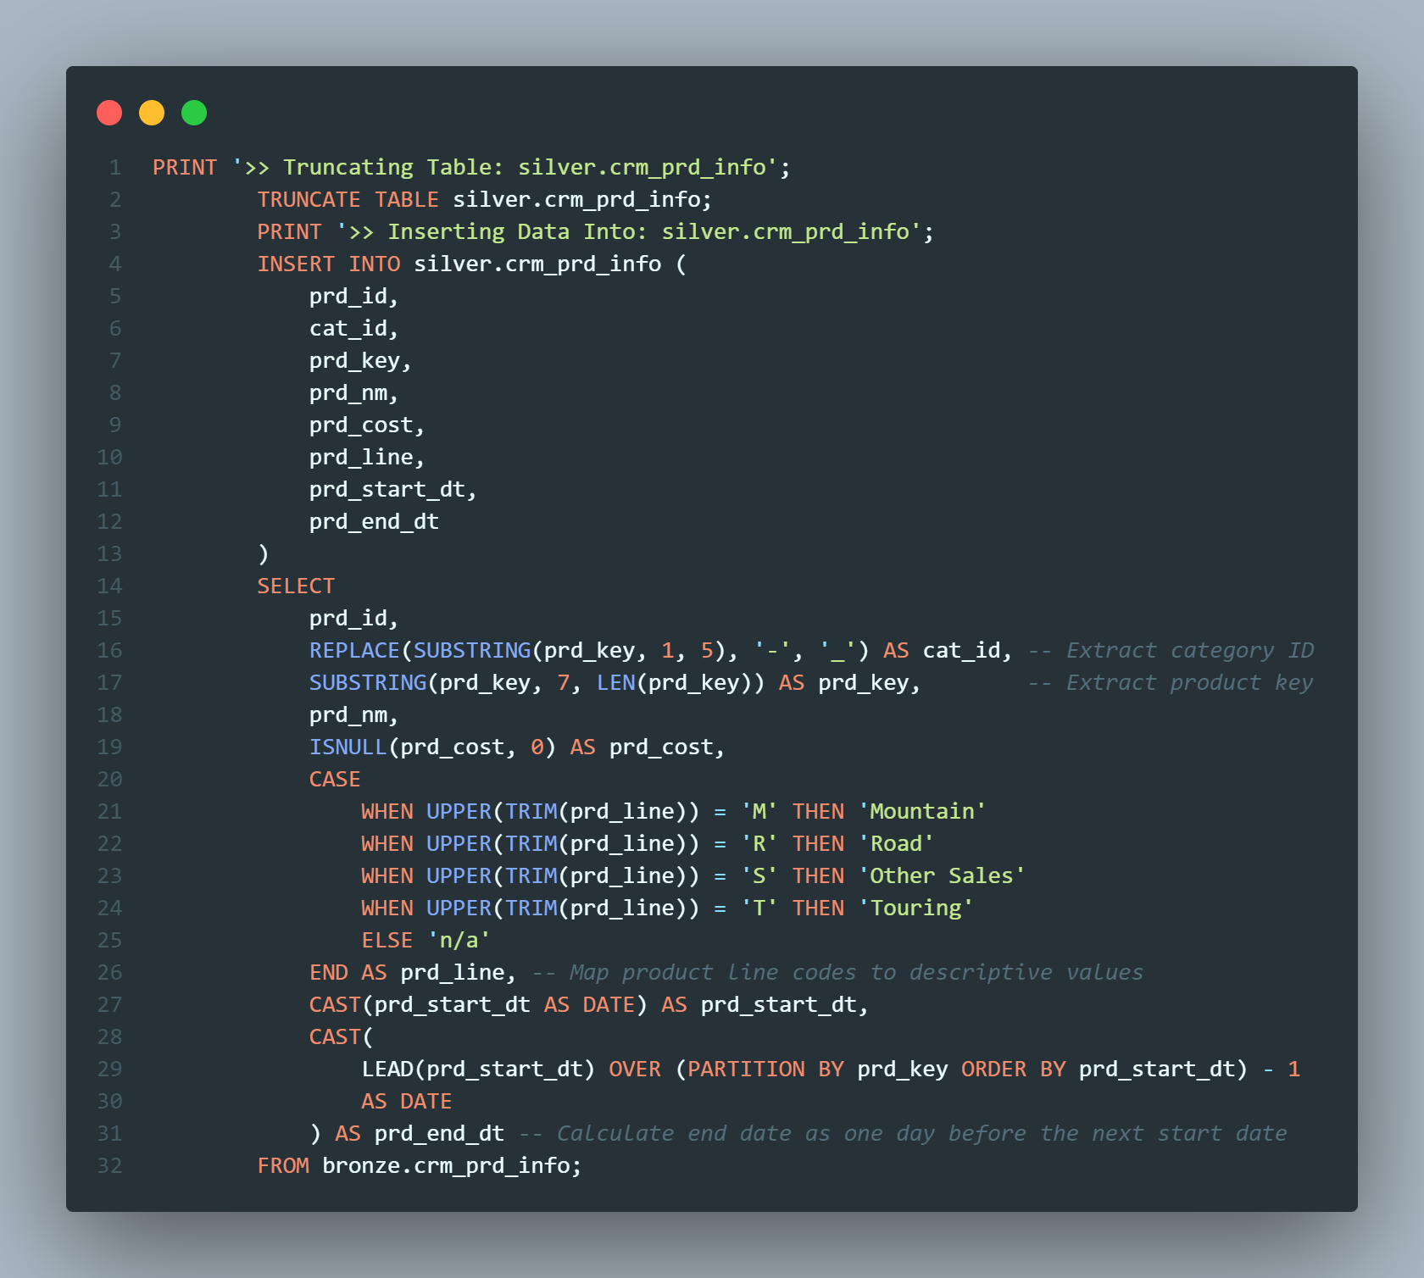
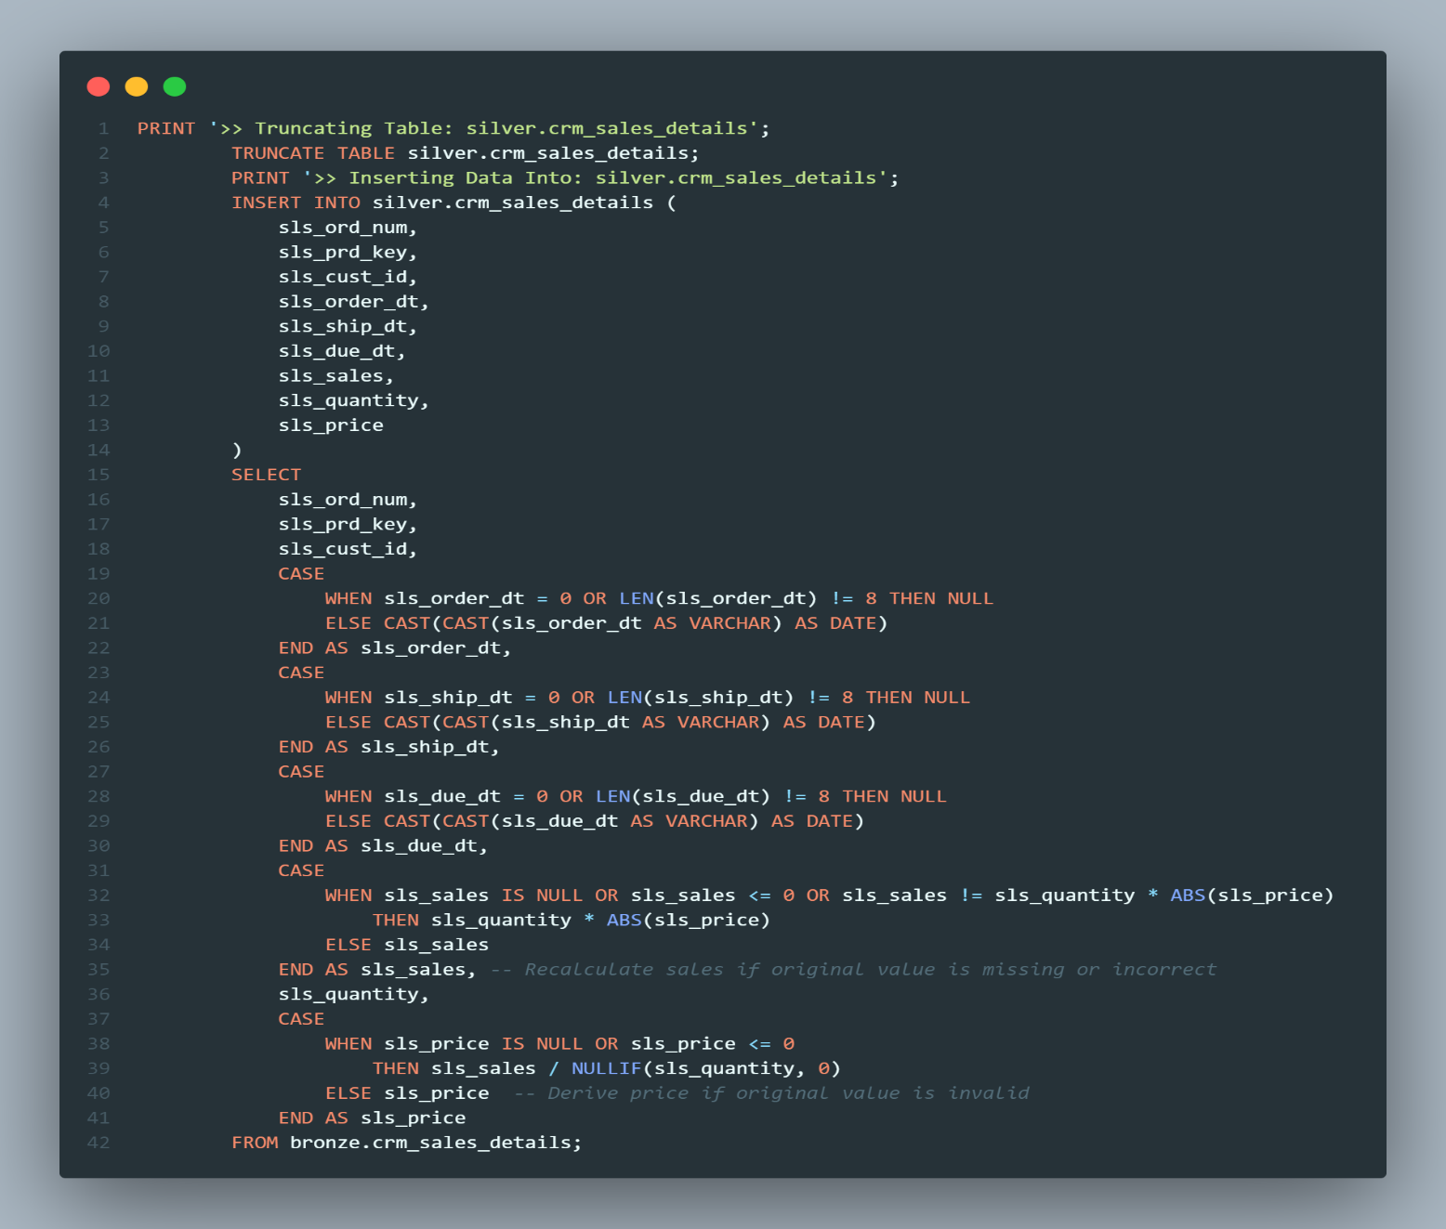
Build Silver Layer
Coding: Data Cleansing
Script Purpose:
This stored procedure performs the ETL (Extract, Transform, Load) process to
populate the 'silver' schema tables from the 'bronze' schema.
Actions Performed:
- Truncates Silver tables.
- Inserts transformed and cleansed data from Bronze into Silver tables.
crm_cust_info Table
crm_prd_info Table
crm_sales_details Table

Slide 18
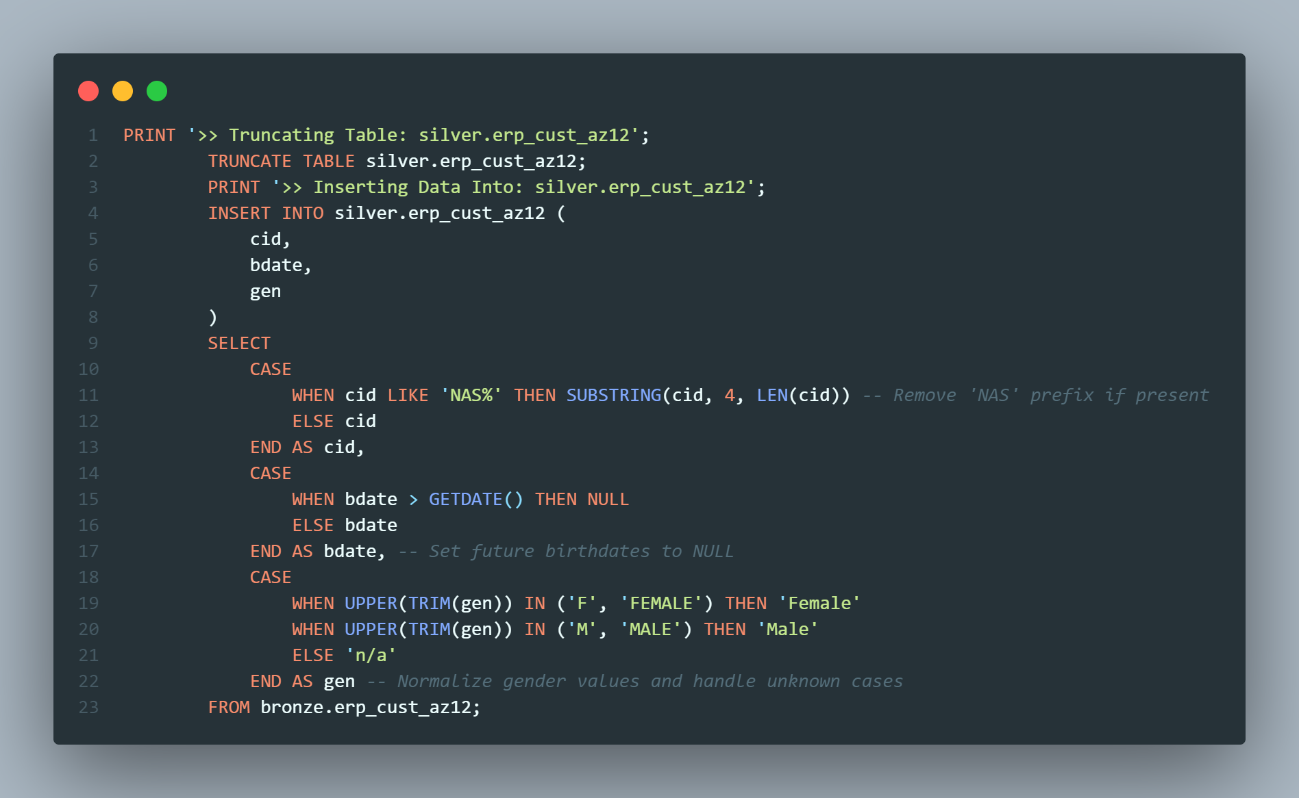
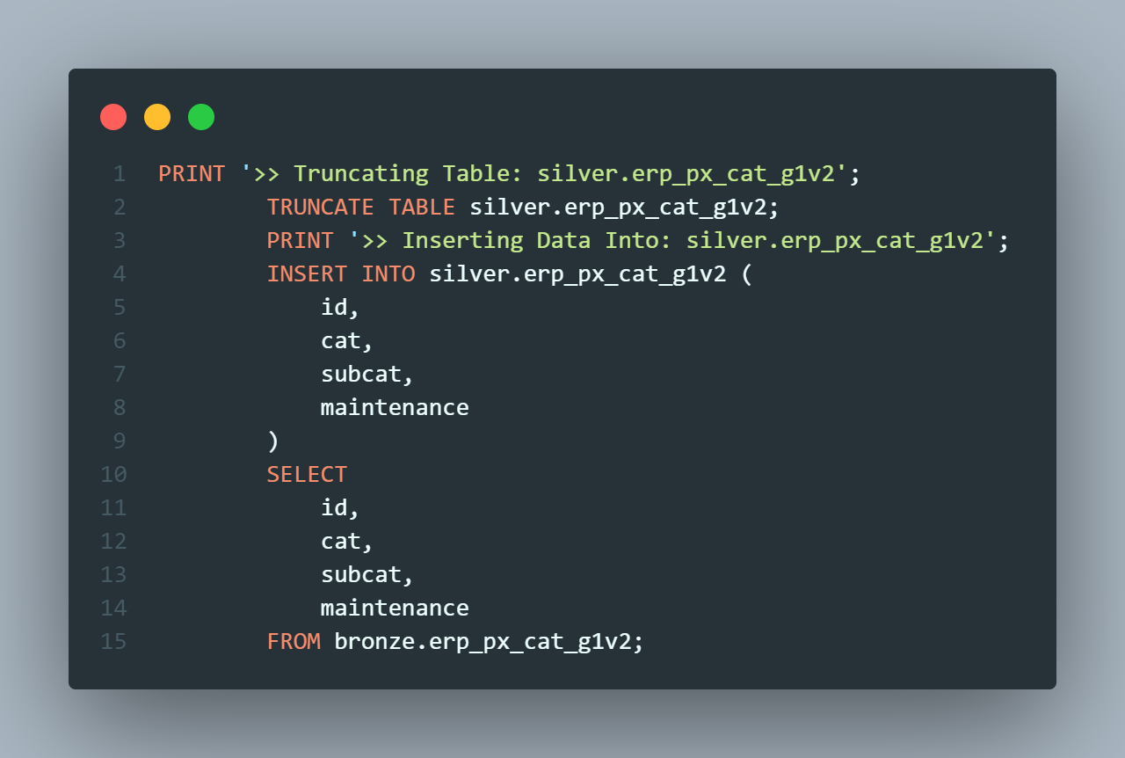
Build Silver Layer
Coding: Data Cleansing
erp_loc_a101 Table
erp_CUST_AZ12 Table
erp_px_cat_g1v2 Table

Slide 19
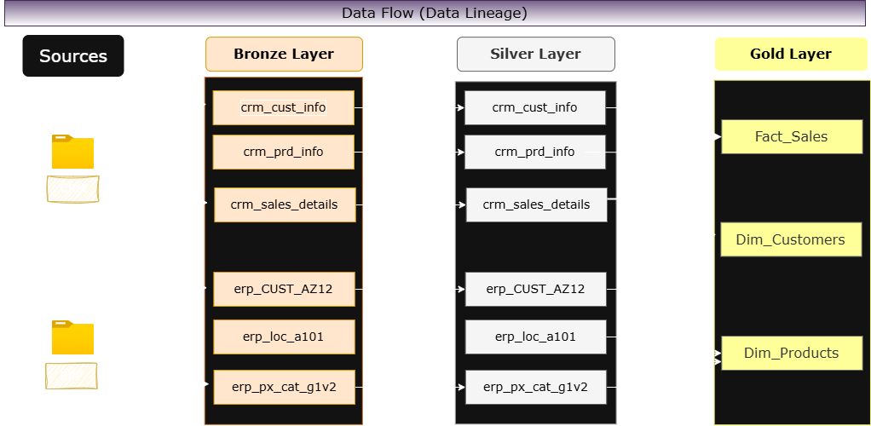
Data Flow

Slide 20

Build Gold Layer
Analyzing: Explore Business Objects
Create SQL-driven analytics to uncover valuable insights into:
Customer Behavior
Product Performance
Sales Trends

Slide 21
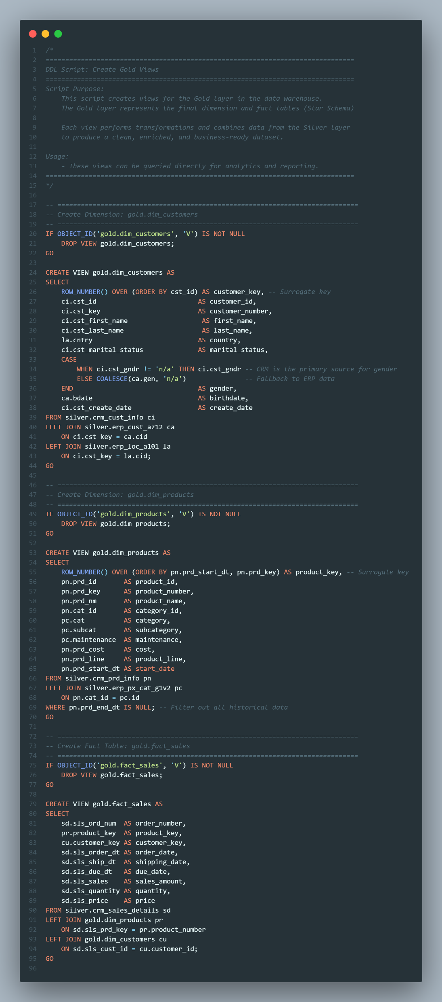
Build Gold Layer
Coding: Data Integration
Script Purpose:
This script creates views for the Gold layer in the data warehouse.
The Gold layer represents the final dimension and fact tables (Star Schema)
Each view performs transformations and combines data from the Silver layer
to produce a clean, enriched, and business-ready dataset.
Dim_Customers
Dim_Products

Slide 22
Build Gold Layer
Coding: Data Integration
Fact Sales

Slide 23
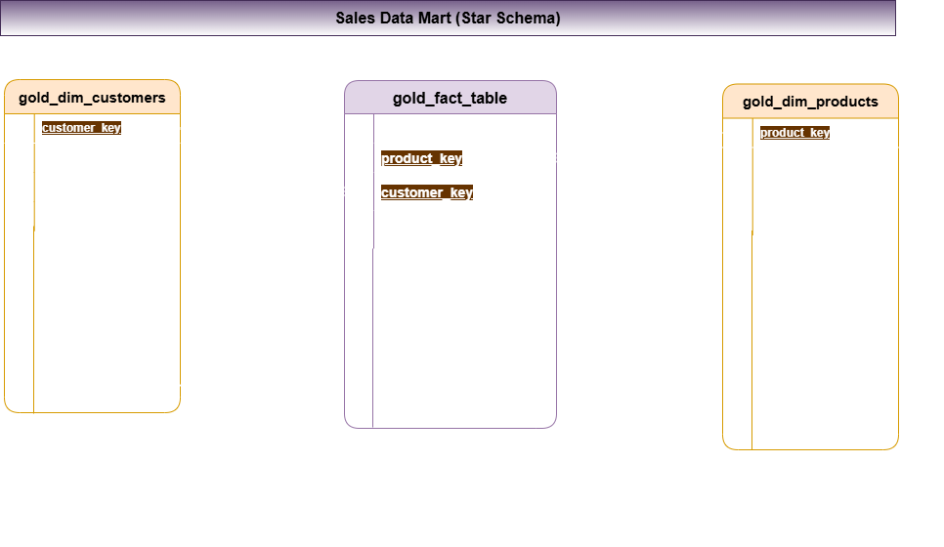
Build Gold Layer
Data Model of Star Schema

Slide 24
Build Gold Layer
Data Catalog
The Gold Layer is the business-level data representation, structured to support analytical and reporting use cases. It consists of dimension tables and fact tables for specific business metrics
gold.dim_customers - Purpose: Stores customer details enriched with demographic and geographic data.
Column Name | Data Type | Description
customer_key | INT | Surrogate key uniquely identifying each customer record in the dimension table.
customer_id | INT | Unique numerical identifier assigned to each customer.
customer_number | NVARCHAR(50) | Alphanumeric identifier representing the customer, used for tracking and referencing.
first_name | NVARCHAR(50) | The customer's first name, as recorded in the system.
last_name | NVARCHAR(50) | The customer's last name or family name.
country | NVARCHAR(50) | The country of residence for the customer (e.g., 'Australia').
marital_status | NVARCHAR(50) | The marital status of the customer (e.g., 'Married', 'Single').
gender | NVARCHAR(50) | The gender of the customer (e.g., 'Male', 'Female', 'n/a').
birthdate | DATE | The date of birth of the customer, formatted as YYYY-MM-DD (e.g., 1971-10-06).
create_date | DATE | The date and time when the customer record was created in the system

Slide 25
Build Gold Layer
Data Catalog
gold.dim_products - Purpose: Provides information about the products and their attributes.
Column Name | Data Type | Description
product_key | INT | Surrogate key uniquely identifying each product record in the product dimension table.
product_id | INT | A unique identifier assigned to the product for internal tracking and referencing.
product_number | NVARCHAR(50) | A structured alphanumeric code representing the product, often used for categorization or inventory.
product_name | NVARCHAR(50) | Descriptive name of the product, including key details such as type, color, and size.
category_id | NVARCHAR(50) | A unique identifier for the product's category, linking to its high-level classification.
category | NVARCHAR(50) | The broader classification of the product (e.g., Bikes, Components) to group related items.
subcategory | NVARCHAR(50) | A more detailed classification of the product within the category, such as product type.
Maintenance _required | NVARCHAR(50) | Indicates whether the product requires maintenance (e.g., 'Yes', 'No').
cost | INT | The cost or base price of the product, measured in monetary units.
product_line | NVARCHAR(50) | The specific product line or series to which the product belongs (e.g., Road, Mountain).
start_date | DATE | The date when the product became available for sale or use, stored in

Slide 26
Build Gold Layer
Data Catalog
gold.fact_sales - Purpose: Stores transactional sales data for analytical purposes.
Column Name | Data Type | Description
order_number | NVARCHAR(50) | A unique alphanumeric identifier for each sales order (e.g., 'SO54496').
product_key | INT | Surrogate key linking the order to the product dimension table.
customer_key | INT | Surrogate key linking the order to the customer dimension table.
order_date | DATE | The date when the order was placed.
shipping_date | DATE | The date when the order was shipped to the customer.
due_date | DATE | The date when the order payment was due.
sales_amount | INT | The total monetary value of the sale for the line item, in whole currency units (e.g., 25).
quantity | INT | The number of units of the product ordered for the line item (e.g., 1).
price | INT | The price per unit of the product for the line item, in whole currency units (e.g., 25).

Slide 27
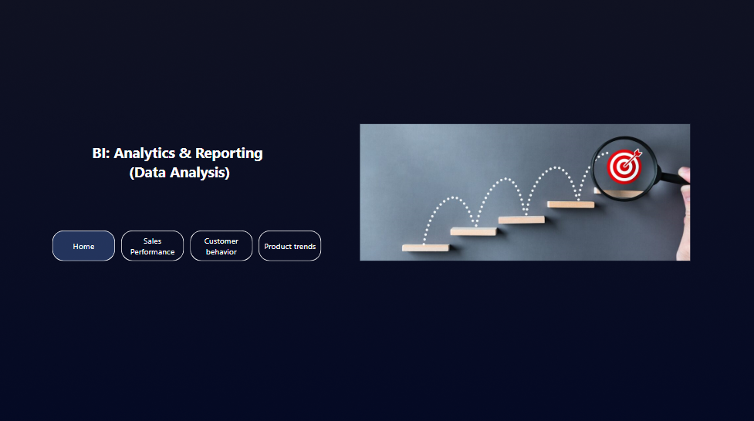
Analytics & Reporting

Slide 28
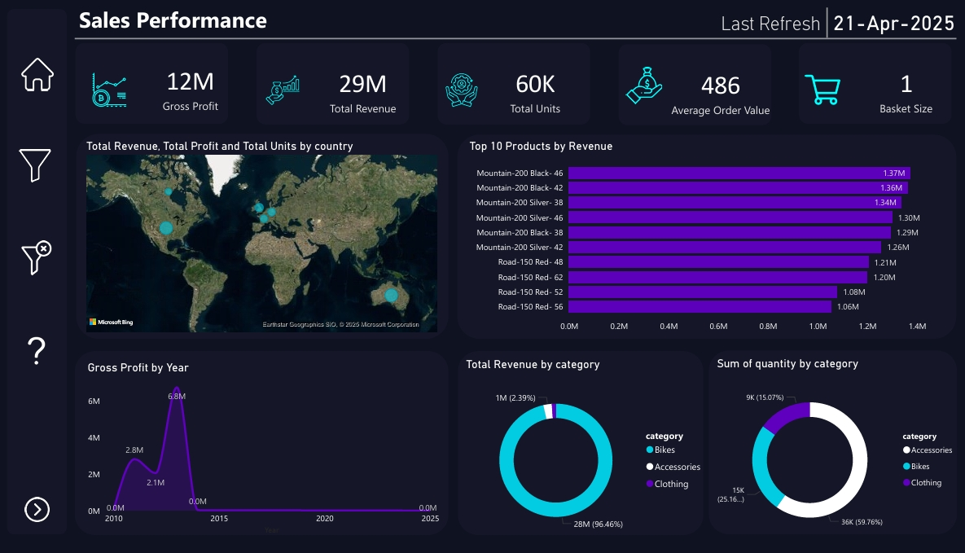
Analytics & Reporting

Slide 29
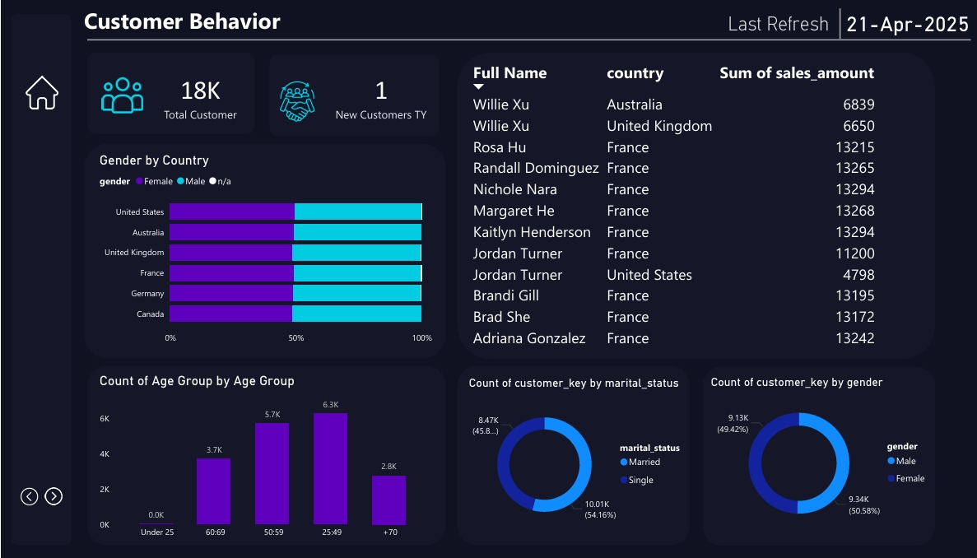
Analytics & Reporting

Slide 30
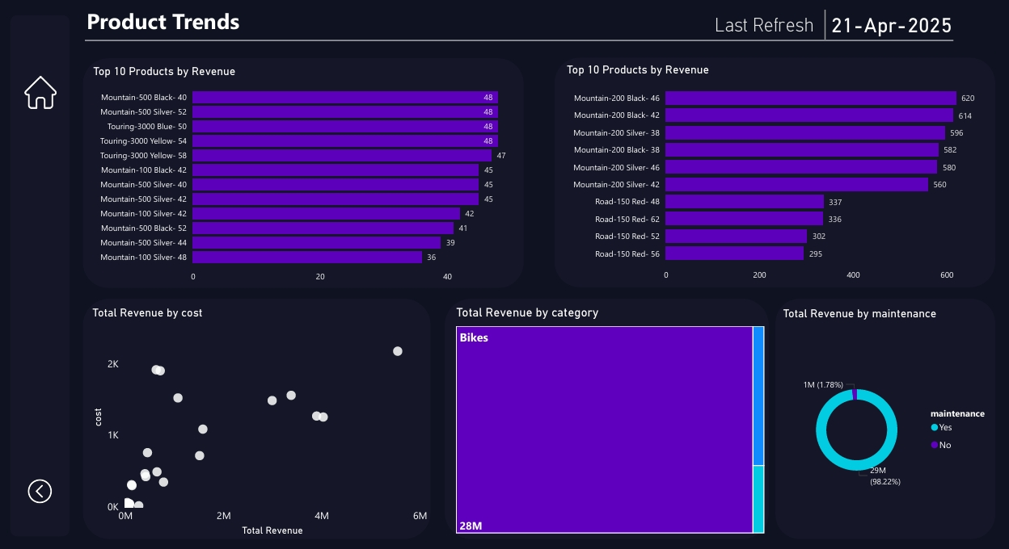
Analytics & Reporting

Slide 31

Recommendations
Investigate 2014’s success in replicating or adapting the strategy.
Expand focus on high-margin products like the Mountain-200 series.
Re-evaluate pricing or bundling for clothing, which is high in volume but low in revenue.
Explore market expansion where performance is currently low, especially in underrepresented regions.
Develop a customer acquisition strategy (referrals, campaigns) to attract more new buyers.
Launch targeted marketing campaigns toward the 25–49 age group, as they form the bulk of customers.
Tailor communications for French customers—they’re high-value clients.
Consider gender- or marital-status-specific promotions to further personalize outreach.
Expand the product line around the Mountain and Touring series, especially variants in black and silver.
Promote or bundle maintenance plans to boost after-sales service revenue.
Highlight the value-for-money products (low cost, high revenue) in promotions.

Slide 32



Thank you
Cairo, Egypt
01223958997
ahmedfmohamed1234567@gmail.com

